Slide 1


CRYPTO DATATHON
Team Name
Innovation Geeks
College
IIM Calcutta
FINANCIAL DELINQUENCY PREDICTIVE ANALYSIS
Girish Dev Kumar Chaurasiya
Sugandha Ranjan
Suman Pal
Name of the Participants

Slide 2

CONTENTS
Introduction
3
Problem Statement
4
Analysis
5
Descriptive Data Analysis
6
Predictive Data Analysis
12
Conclusion and discussion
14
Future Scope and recommendations
16

Slide 3

INTRODUCTION
TVS credit, a financial services company under this group, operating across 21 states, aims to empower Indians from various socioeconomic backgrounds with financial products serving their needs.
TVS is one of India's largest diversified industrial conglomerates with its principal headquarters located in Madurai and international headquarters in Chennai.
This new venture into consumer durables poses certain challenges for the company with respect to tracking of prospective loan defaulters.
In addition to the existing auto financing services services, in 2017, TVS Credit entered the consumer durable financing segment, thereby marking its first venture outside automobile finance.

Slide 4

PROBLEM STATEMENT
For a financial services firm, It is pertinent to ensure payments of installment within stipulated time period. Hence, company shall track customers who don’t pay the debt/EMI in time even until the end of the month. Post default on payment, these customers are termed as flow customers.
After several attempts, customers who are not able to pay in that month are moved to N+1 from N existing payment defaults i.e. moved to the next bucket.
Objective of this exercise is to predict which customer is going to flow to N+1 bucket in coming month based on their past payment history, previous month collection, demographics, profile, external data etc.

Slide 5
ANALYSIS
Diagnostic
Predictive
Prescriptive
We shall start with exploring the variables provided in the dataset and try to understand the information it contains regarding their distribution. Further, we shall perform an elementary analysis on their mutual correlation.
Predictive analytics will be carried out in order to estimate the potential defaulters. As a part of this exercise, we will also try to figure out various important variables helping in estimation prospective defaulters.
We will try to gauge and present some insights on the reasoning pertaining to data and their mutual relationships.
Finally, some assessments that might help TVS in future to better assess prospective defaulters and improve their performance and overall profitability.
Descriptive

Slide 6
DESCRIPTIVE DATA ANALYSIS
Number of times the customer flowed in the last 3 months
Total number of times the customer flowed so far
Qualification
Variable V4 indicate that most of the customers (75%) tend to pay their EMI on time. However around 25% of them have defaulted at least once in last 3 months.
Variable V3 which indicates total number of times customer as flowed so far indicates a similar trend as V4
It is also pertinent to note that around 56% of the costumers have education levels of below 12th which might be a crucial information as education levels might affect chances of defaulting.

Slide 7
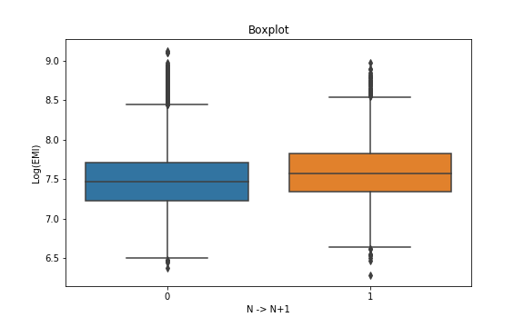
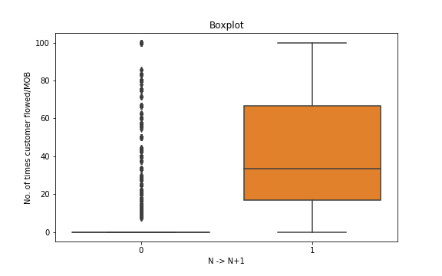
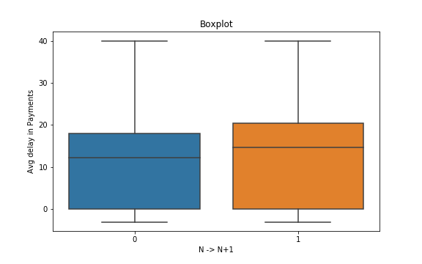
DESCRIPTIVE DATA ANALYSIS
Average delay in case of defaulter shows a higher level of variance. Also it is apparent, that the defaulters tend to have comparatively a higher level of delay.
Even though it is expected that defaults should increase with increase in EMI, Boxplot presented here contradicts it. Based on the boxplot, it can be inferred that Higher level of EMI is not likely to play a major factor in defaulting on EMI payment
One of the important variables to note is no. of times customer has flowed in past. We can interpret from the boxplot that a customer who flowed in past is highly likely to flow again.

Slide 8
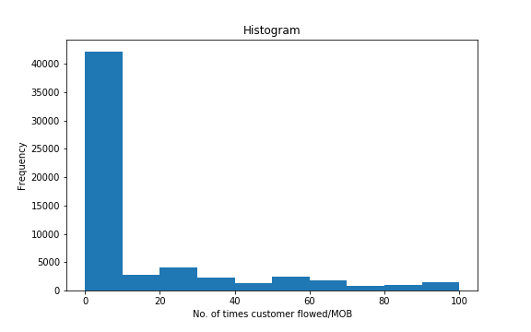
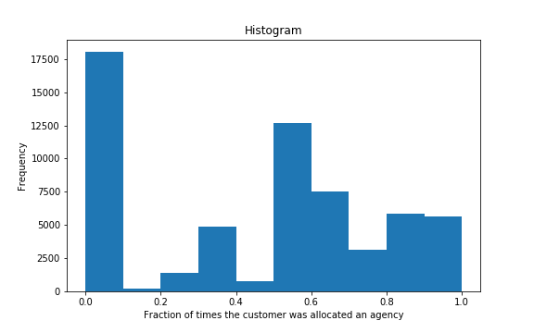
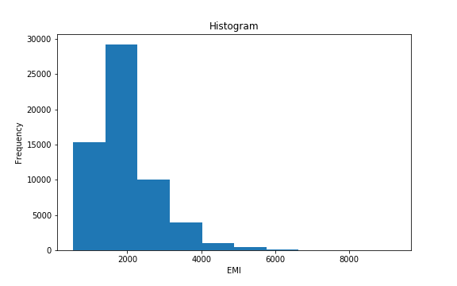
DESCRIPTIVE DATA ANALYSIS
The distribution of No. of times customer flowed/Month On Book (V20) shows that most of the customers fall in the range of (0-10) and remaining values have significantly less no. of customers.
Fraction of times the customer was allocated to a collection agency (V25) has high no. of customers for values greater than .5 as well as for 0. It can be inferred that customers who tend to pay their EMI on time will keep on practicing it. On the contrary, customers who have defaulted once are likely default half of their payments.
From the histogram plot of EMI(V16), it is evident that the customers with low EMI (between 0-2000) are more in no. and hence, the graph is positively skewed.

Slide 9
DESCRIPTIVE DATA ANALYSIS
The frequency plot depicts the relationship between the defaulter count and Qualification. It can be inferred that although the proportions in all categories are comparable. However, proportions slightly decrease with increase in education levels.
The frequency plot depicts the relationship between the defaulter count and Bounce reason. For defaulters proportion of non-technical bounces to technical bounces is higher than non-defaulters
No. of Defaulters Vs Bounce reason

Slide 10
DESCRIPTIVE DATA ANALYSIS
The adjacent two plots show the relation of proportion of defaulters with respect to no. of times customer flowed in the last 3 months(V4) and total no. of times(V3).
It can be seen that for customers who do not default at all in the last 3 months or otherwise, the defaulter count/proportion is very low. As the number of times of default in past increases, the chances of defaulting in the current month increases.
-Number of times the customer flowed in the last 3 months

Slide 11
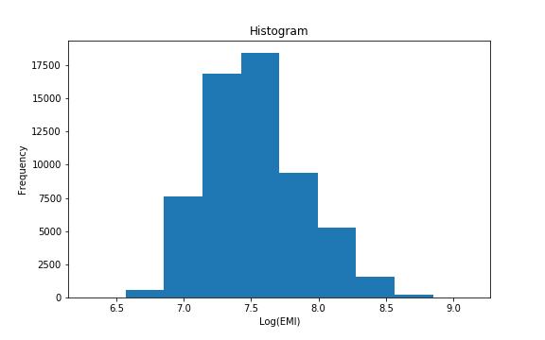
PREDICTIVE DATA ANALYSIS
FEATURE GENERATION:
One hot encoding: one hot encoding is performed with most of the categorical variable.
Extracting locations from Pin-code: We have extracted the regions of the customer to which they belong by categorizing their location based on the first two digits of the Pin code. Following is a information generated from the extraction of images
Logarithm of the EMI data has been taken to remove the positive skewness of the data.

Slide 12

PREDICTIVE DATA ANALYSIS
Confusion matrix
ERROR RATE: .14
Variables V25 and V26 indicate the fraction of time customers were assigned various agencies separately. We have clubbed them together to get the required information as a single feature.
10 Fold
Cross Validation
Variable V13 is Aadhar information whereas V23 is PAN Card/ Voter ID information both have been clubbed together as they indicate the identity of customers.
XG-Boost and Random forest are two tree based model which have been used here to classify customers in two classes of N and N+1 buckets. In addition to this, method parameters are tuned to minimize error rates.

Slide 13
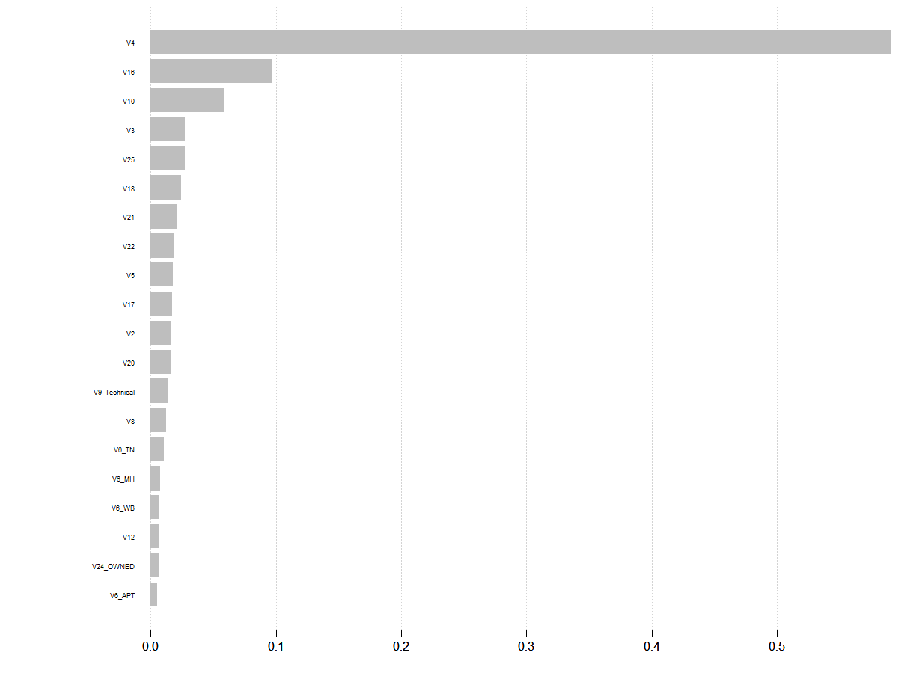
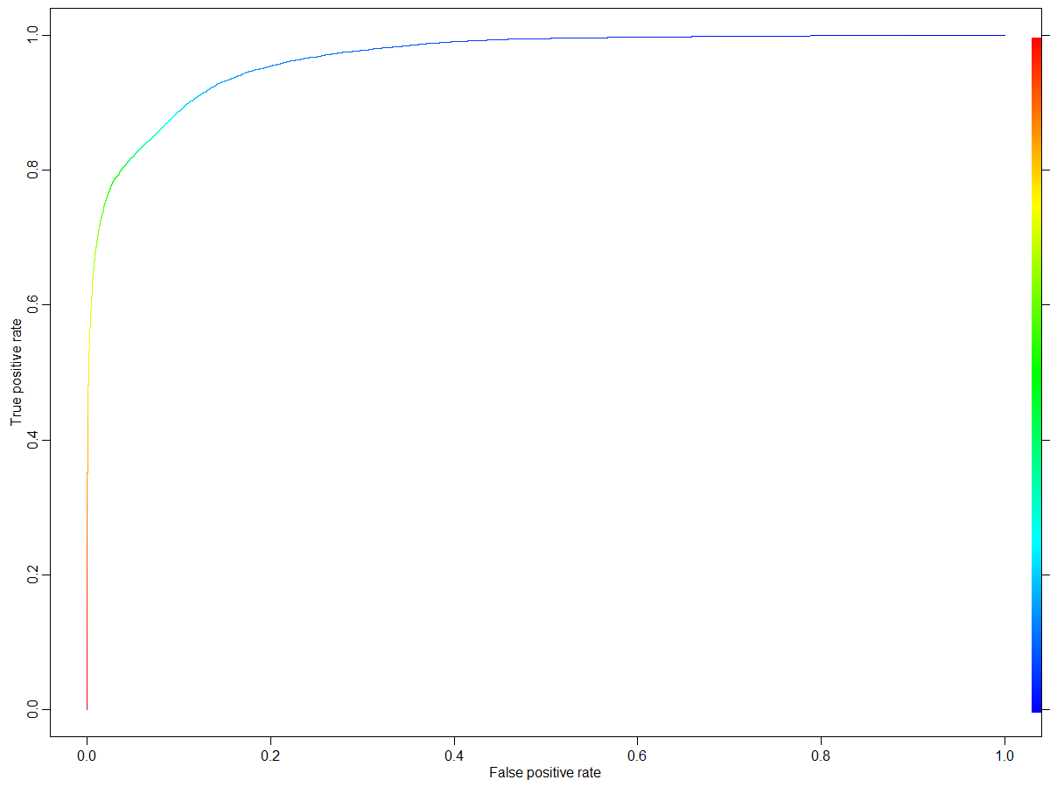
PREDICTIVE DATA ANALYSIS
Using aforementioned models, important variables as per splits of the variables which resulted in maximum increase in the accuracy of the model on an average are recorded and a plot indicating the same is presented.
Threshold has been reduced to accommodate for high AUC value of 88 % to improve the predictability of true positive rates without affecting true negative rates significantly.

Slide 14
CONCLUSION & DISCUSSION
Following are some of the important variables explaining the defaulting costumers:
Variable ID | Description
V4 | Number of times the customer flowed in the last 3 months
V16 | EMI
V10 | Average delay in EMI payment (delay is the difference between the payment date and presentation date)
V3 | Total number of times the customer flowed so far
V25+V26 | Fraction of times the customer was allocated to agency
V18 | Qualification
V21 | Indicates the maximum continuous mobs in which the customer flowed
V22 | Tenure
V5 | Total enquiries made by the customer in the last 9 months
V20 | Number of times the customer flowed/MOB

Slide 15
CONCLUSION & DISCUSSION
Conclusion and Discussions
It can be fairly said that V4, Number of times the customer flowed in the last 3 months, is the most important factor in predicting whether a customer is a potential defaulter.
It is also of importance to note that surrogate, state (derived from PIN code) and resident type do not contribute much towards the assessment of customers defaulting on payments.
Variable V3 which indicates total number of times the customer flowed so far also affects the chances of a customer defaulting on EMI payment
Variable V4 is followed by (V16) EMI amount, and (V10) average delay in EMI payment.

Slide 16
FUTURE SCOPE AND RECOMMENDATIONS
Based on the variables following is recommended for TVS credit. It is observed that customers defaulted for last 3 months are highly likely to default in current month as well . Hence, It is prudent for TVS Credit to generate a mechanism which can identify such customers and store the information to improve their database. Such database might be leveraged to estimate whether a customer is a prospective defaulter.
Further, other ML tools for classification might be performed on the trained data and scope of improvement in test accuracy may be assessed.
In addition to the above, to improve the predictability of ML model developed, further feature engineering on the variables shall be performed and the model shall be retrained.

